Slide 1
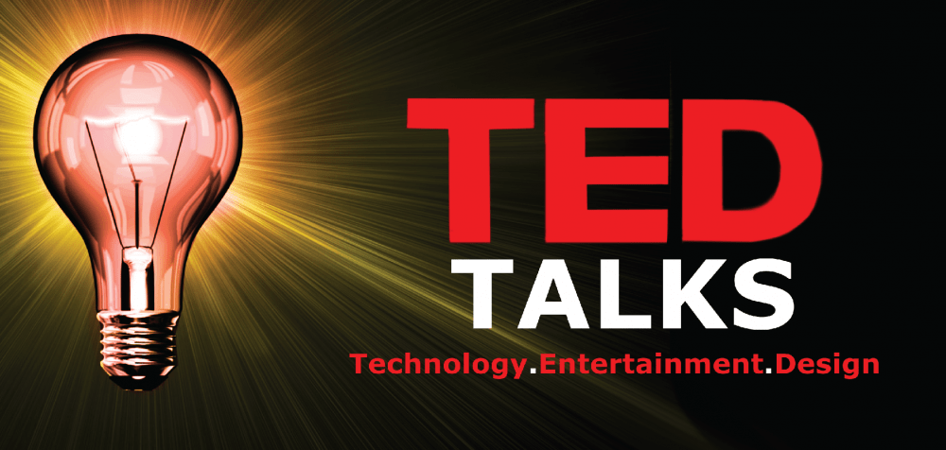
TED Talk Views Prediction
CAPSTONE PROJECT
Presented By:
K.Bhargava Rayal
PVKK Institution Of Technology
BTech
ECE Department

Slide 2
content
Problem Statement
Proposed System/Solution
System Development Approach
Algorithm & Deployment
Result
Conclusion
Future Scope Of Work
Challenge Faced
References

Slide 3
Problem Statement
TED is devoted to spreading powerful ideas on just about any topic. These datasets contain over 4,000 TED talks including transcripts in many languages. Founded in 1984 by Richard Salman as a non-profit organization that aimed at bringing experts from the fields of Technology, Entertainment, and Design together, TED Conferences have gone on to become the Mecca of ideas from virtually all walks of life. As of 2015, TED and its sister TEDx chapters have published more than 2000 talks for free consumption by the masses and its speaker list boasts of the likes of Al Gore, Jimmy Wales, Shahrukh Khan, and Bill Gates. The main objective is to build a predictive model, which could help in predicting the views of the videos uploaded on the TEDx website.

Slide 4
Proposed Solution
Predicting TED Talk views can be a complex task that involves various factors such as the topic, speaker, timing, promotion, and audience engagement. Here's a proposed system/solution for predicting TED Talk views:
Data Collection and Pre-processing:
Gather TED talk data, including features like talk titles, speaker information, event details, and language.
Clean the data by handling missing values and encoding categorical variables.
Feature Engineering:
Extract relevant information from text features (e.g., talk titles).
Create additional features if needed (e.g., talk duration, number of languages spoken).
Exploratory Data Analysis (EDA):
Understand feature distributions.
Identify correlations between features and views.

Slide 5
Model Selection and Training:
Choose appropriate regression algorithms (e.g., linear regression, random forest).
Split the data into training and validation sets.
Train the model using the training data.
Model Evaluation:
Evaluate model performance using metrics like Root Mean Squared Error (RMSE) and R-squared.
Fine-tune hyper parameters if necessary.
Insights and Interpretation:
Analyser feature importance to understand what drives views.
Provide actionable insights for improving talk popularity.
Deployment and Monitoring:
Deploy the trained model for predictions.
Monitor its performance over time.
Feedback Loop:
Incorporate feedback from actual TED Talk view counts to iteratively improve the model's accuracy and relevance.
User Interface:
Develop a user-friendly interface where users can input data about a TED Talk, and the system provides a predicted range or number of views.

Slide 6
System Approach
Predicting the views of a TED Talk based solely on the system approach and technology used requires considering several factors. Here's how you might approach it:
Topic Novelty and Relevance: If the system approach or technology discussed is cutting-edge, novel, or addresses a pressing issue, it may attract more views due to its inherent interest.
Speaker Authority: The credibility and reputation of the speaker play a significant role. An expert in the field or someone with a unique perspective is more likely to garner attention.
Audience Appeal: Consider the potential audience for the topic. Some topics have broader appeal and are more likely to attract a larger viewership.
Previous TED Talk Performance: If the speaker has given TED Talks before, their previous performance and the views those talks garnered could be indicative of potential viewership for the new talk.
Promotion and Marketing: TED often promotes talks through its website, social media channels, and other platforms. The level of promotion can influence the number of views a talk receives.

Slide 7
Technology Impact: Assess how deeply the technology discussed in the talk affects people's lives or industries. Talks about transformative technologies tend to attract more views.
Emotional Engagement: Talks that evoke strong emotions or tell compelling stories tend to be more widely shared and thus attract more views.
Length and Format: Shorter talks may have higher viewership due to being more digestible, but longer talks can also attract dedicated viewers if the content is engaging.
Current Events and Trends: Talks that tie into current events or trends may see increased viewership due to relevance.
Main Libraries to be Used:
Pandas for data manipulation, aggregation
Matplotlib and Seaborn for visualisation and behaviour with respect to the target variable
NumPy for computationally efficient operations
Scikit Learn for model training, model optimization, and metrics calculation

Slide 8
Library required to build the model:
Scikit-learn: This is a widely used machine learning library that provides various algorithms for classification, regression, clustering, and dimensionality reduction. It's beginner-friendly and well-documented.
Tensor Flow / Keras: Tensor Flow is an open-source machine learning library developed by Google, primarily used for deep learning tasks. Keras is a high-level neural networks API that runs on top of Tensor Flow, making it easier to build and experiment with deep learning models.
PyTorch: PyTorch is another popular deep learning library that offers dynamic computation graphs, making it particularly suitable for research and experimentation. It's known for its flexibility and ease of use.
XG Boost / Light GBM / Cat Boost: These are gradient boosting libraries that are highly effective for regression and classification tasks. They often perform well out of the box and are widely used in competitions and real-world applications.

Slide 9
Pandas: Pandas is a powerful data manipulation and analysis library that provides data structures like Data Frames, which are ideal for handling tabular data commonly used in machine learning tasks.
NumPy: NumPy is a fundamental package for scientific computing in Python. It provides support for large, multi-dimensional arrays and matrices, along with a collection of mathematical functions to operate on these arrays.
Matplotlib / Seaborn: These libraries are used for data visualization in Python. They offer a wide range of plotting functions to create informative and visually appealing visualizations of your data.
SciPy: SciPy is a library used for scientific and technical computing. It builds on NumPy and provides additional modules for optimization, integration, interpolation, and other numerical algorithms.

Slide 10
Algorithm & Deployment
The algorithm and deployment process for a TED Talk Views Prediction system typically involves the following steps:
Algorithm Selection: Various machine learning algorithms like Random Forest, XG Boost, and Cat Boost can be used to build the predictive model
Hyper parameter Tuning: Techniques like Random Search CV are used for tuning the hyper parameters of the model to improve its performance
Evaluation: The performance of the model is evaluated using appropriate metrics.
Deployment: The final model is then deployed to predict the views of new TED Talk videos. The deployment process may vary depending on the specific requirements of the project and the platform where the model is being deployed.
Retraining: The model should be retrained often when new data is collected to ensure its performance remains optimal.

Slide 11
Result
The results of TED Talk Views Prediction projects vary depending on the specific model and data used. However, some projects on GitHub have reported being able to correctly predict views 90% of the time. After hyper parameter tuning, these projects have prevented over fitting and decreased errors by regularizing and reducing the learning rate. Please note that these results are based on the specific datasets and methodologies used in these projects, and results may vary with different approaches or data.

Slide 12
Conclusion
That's it! We reached the end of our exercise.
Started with loading the data so far we have done EDA ,feature engineering , data cleaning, target encoding and one hot encoding of categorical columns, feature selection and then model building.
So far we have modelled on
Lasso Regressor
Ridge Regressor
Knearest Neighbours Regressor
Random Forest Regressor
In all of these models our errors have been in the range of 2,00,000 which is around 10% of the average views. We have been able to correctly predict views 90% of the time. After hyper parameter tuning, we have prevented over fitting and decreased errors by regularizing and reducing learning rate. Given that only have 10% errors, our models have performed very well on unseen data due to various factors like feature selection, correct model selection,etc. In all the features speaker_wise_avg_views is most important this implies that speakers are directly impacting the views.

Slide 13
Future scope of work
The dataset contains features like:
talk_id: Talk identification number provided by TED
title: Title of the talk
speaker_1: First speaker in TED's speaker list
all_speakers: Speakers in the talk
occupations: Occupations of the speakers
about_speakers: Blurb about each speaker
recorded_date: Date the talk was recorded
published_date: Date the talk was published to TED.com
event: Event or medium in which the talk was given
native_lang: Language the talk was given in
available_lang: All available languages (lang_code) for a talk
comments: Count of comments
duration: Duration in seconds
topics: Related tags or topics for the talk
related_talks: Related talks (key='talk_id',value='title')
url: URL of the talk
description: Description of the talk
transcript: Full transcript of the talk

Slide 14
References
SarangGami/TED-Talks-Views-Prediction-Supervised-learning: This project aims to build a regression model that predicts the number of views for TED Talks videos on the TED website.
BhanuPShahi/TED-talk-views-prediction: This project is also devoted to building a predictive model for predicting the views of the videos uploaded on the TEDx website.
Predicting TED Talk Ratings from Language and Prosody - arXiv.org: This paper uses TED Talks to predict the ratings of the online viewers. It contains over 2200 TED Talk transcripts, audio features, and the associated meta information including about 5.5 Million ratings from spontaneous visitors of the website.
paulsoumyadip/ted_talk_views_prediction: This project contains over 4,000 TED talks including transcripts in many languages and aims at predicting the views of TED Talks.

Slide 15
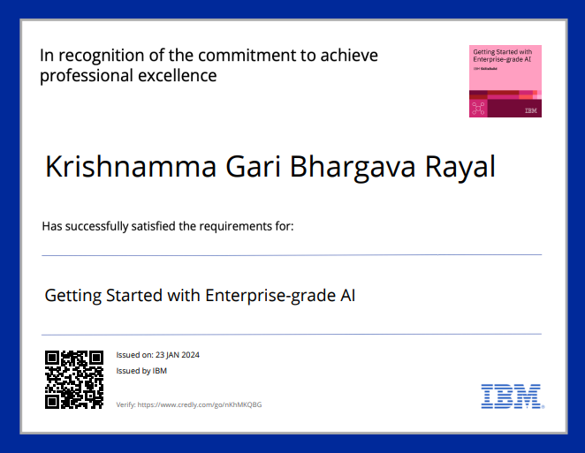
course certificate 1

Slide 16
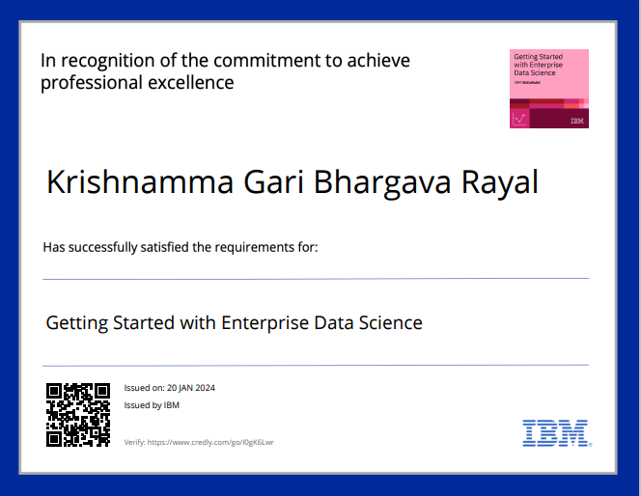
course certificate 2

Slide 17
THANK YOU

